Slide 1
@KristijanPuksic
Sam si hitrejši, daleč prideš le s pravo ekipo

Slide 2
https://www.youtube.com/watch?v=h-0y7XUnSyA

Slide 3
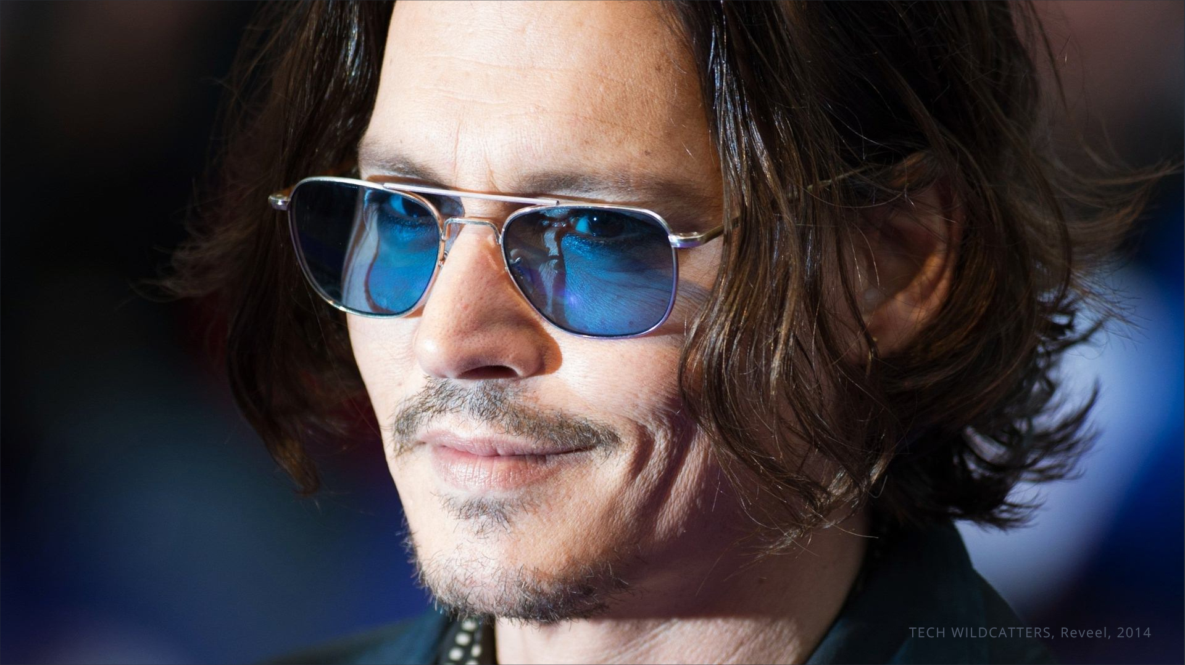

Slide 4
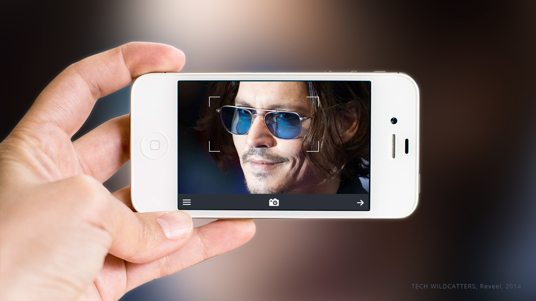

Slide 5
Re Time Transactions

Slide 14
Team today
2x business development
1x design
4x programming
2x tagging products
1x sales US
3x mentors US
… you?

Slide 15
CASE STUDY – BR4SS
https://vimeo.com/103274221

Slide 21
@KristijanPuksic
Ekipa je ključ do uspeha.

